Slide 1
Software-ontwerp
Presentatie: Iteratie 2
Karina Karapetyan
Laurens Cleemput
Tom Houben
Tri Tran

Slide 2
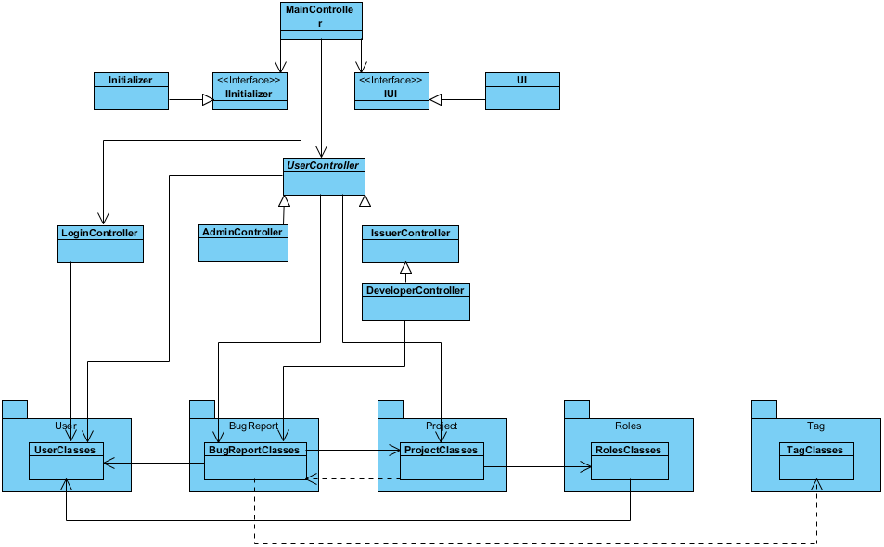
High Level Design
Algemeen voor alle delen: eerst recap van deel 1 (KORT)
// Laurens //
Extra laag met use cases
Domeinlaag: meer packages

Slide 3
More detailed parts
Services niet meer uitleggen
Uitleg over structuur van use cases (bij extensibility use case toevoegen op uml) + eerste deel van use case SD laten zien tot run()
Uitleg over design patterns: Observer, Memento, Stat + Strat ?
Tonen en uitleggen van sequence diagrams voor de meest complexe use cases, bij voorkeur met link voor design patterns

Slide 4
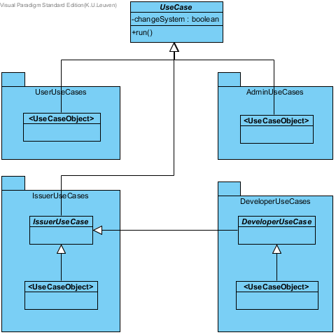
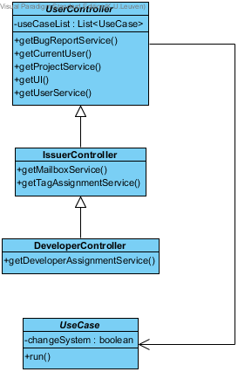
Use Cases

Slide 5
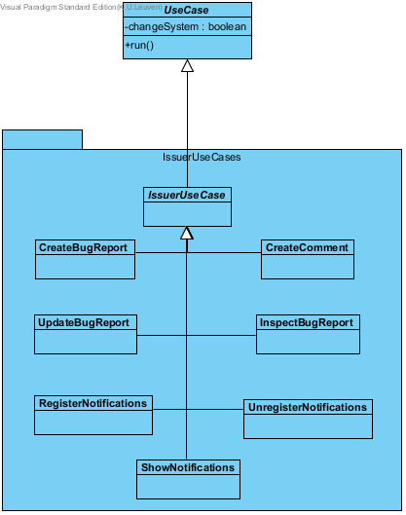
Use Cases: Example

Slide 6
State Pattern
Tags zijn STATES
Het gedrag van Bugreport is afhankelijk van de tag die toegekend is.

Slide 7
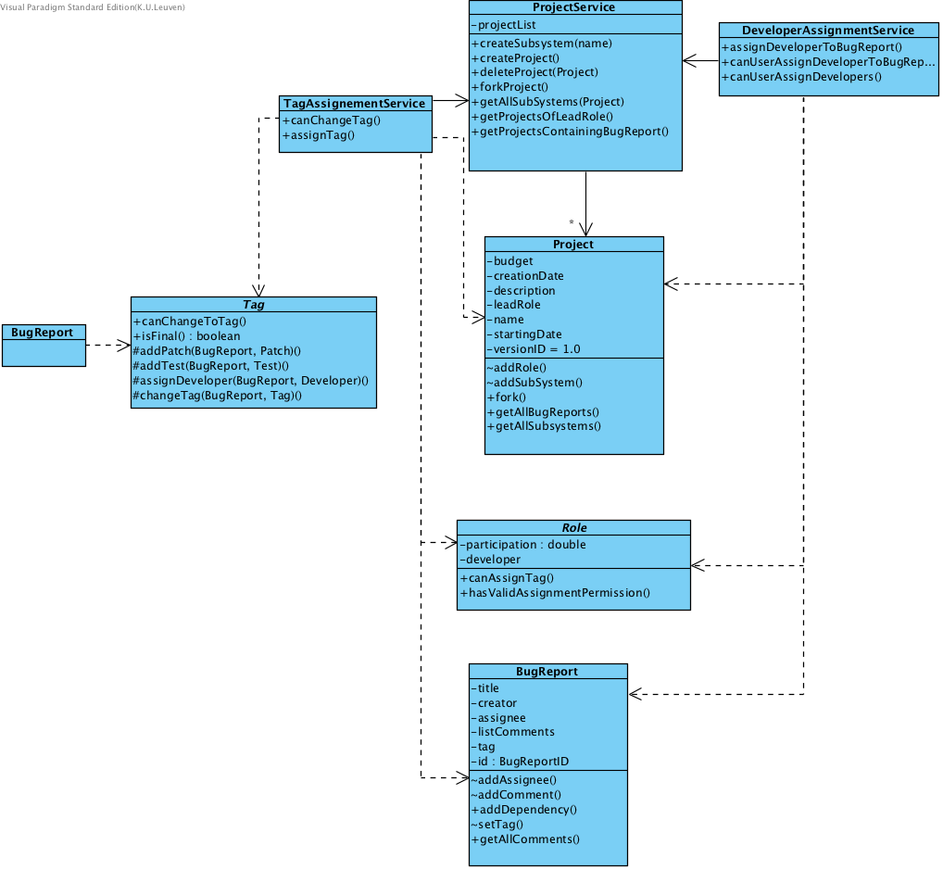
Usage of the domain layer

Slide 8
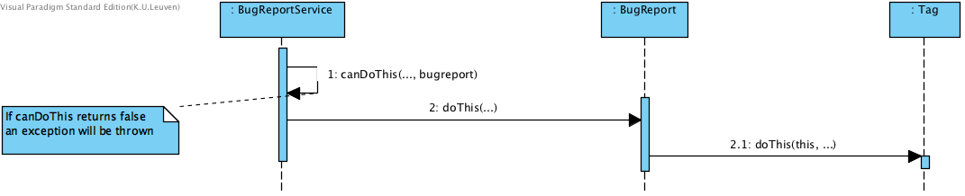
State pattern: Abstract
BugReport calls Tag to execute the function

Slide 9
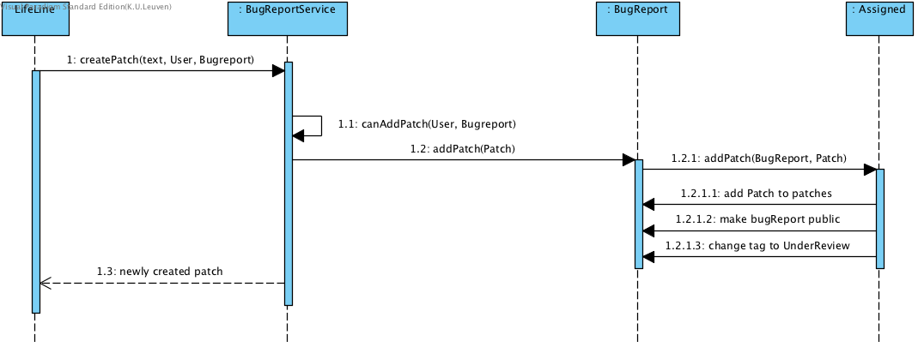
State pattern: Concrete Example
“When a bug report is created, it can be marked as private. … Once the first patch is submitted for the bug report, it is visible for all the users of BugTrap.”
“…after the first patch, the tag of the bug report at stake transitions from Assigned to UnderReview.”
:User

Slide 10
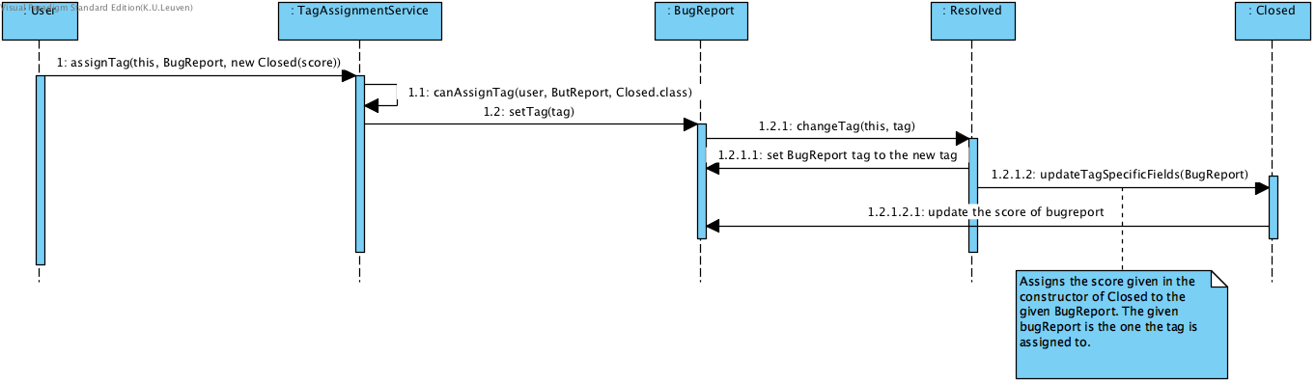
Tag specifieke informatie
“As a final step, the creator of a resolved bug report can close it (i.e. assign the tag Closed) by specifying how satisfied he is with the solution.”

Slide 11
Insert heel korte uitleg over milestones

Slide 12
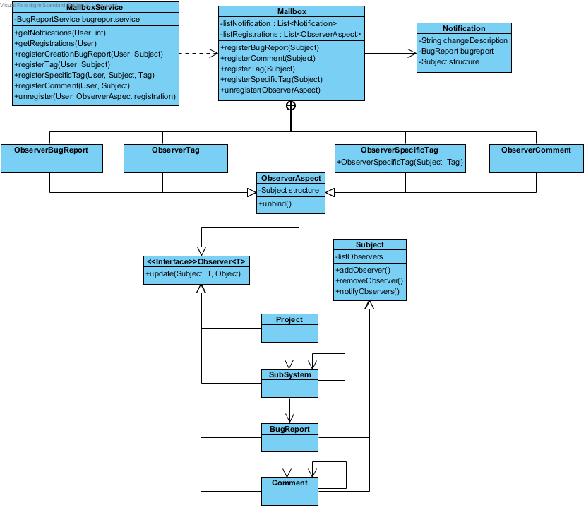
Mailbox system

Slide 13
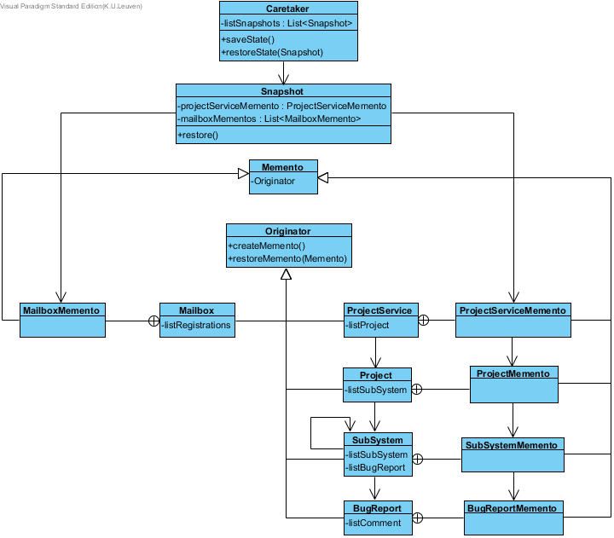
Undo mechanism

Slide 14
Extensibility of the system:
It’s easier to add use cases than last time
UI is still completely independent
Interface for the Initializer
Adding constraints concerning tag
Adding new registration types = adding new observers
Search methods for bug reports
Adding new objects that could be undone
It was easy to implement the changes from iteration 2 -> great extensibility of our code from iteration 1

Slide 15
Possible improvements
MailboxService creates Observers
Milestone improvements in the code and structure
Setters & Getters

Slide 16
Testing approach
Geef coverage + korte samenvatting van werkwijze in iteratie 1

Slide 17
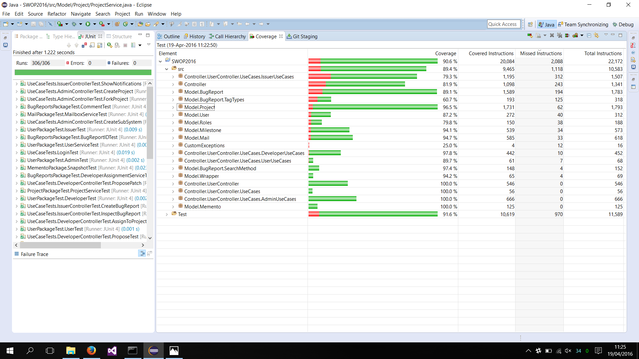
Testing approach

Slide 18

Vragen?

Slide 19
Project management (in uren) TODO UPDATE
Karina Karapetyan
Group work: Individual Work: Study:
Laurens Cleemput
Group work: Individual Work: Study:
Tom Houben
Group work: Individual Work: Study:
Tri Tran
Group work: 31h Individual Work: Study:

Slide 20
Roles
 | Iteratie 1 | Iteratie 2 | Iteratie 3
Design Coordinator | Karina Karapetyan Laurens Cleemput | Tom Houben Karina Karapetyan | TODO INVULLEN (Doorschuiven)
Testing Coordinator | Tri Tran | Laurens Cleemput
Domain Coordinator | Tom Houben | Tri Tran

